Slide 1
Sample Presentation with LaTeX Math
Your Name

Slide 2
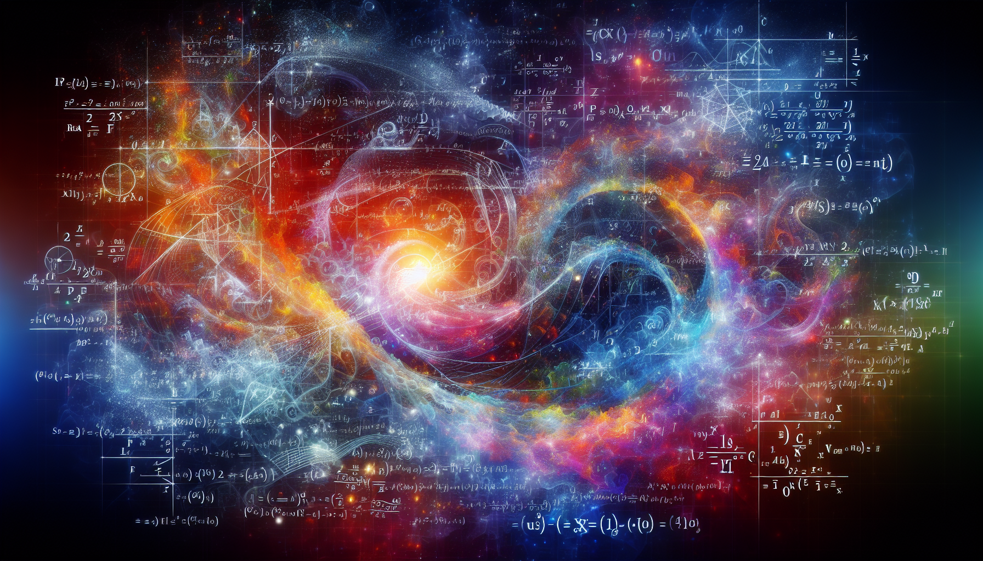
Introduction
This is a sample presentation demonstrating LaTeX equations in Quarto.
Inline math: The famous equation is $E=mc^{2}$
Display equations work too
Multiple formats supported
AI Prompt: “Abstract colorful visualization of mathematical equations and physics formulas floating in space”
AI Image: Abstract representation of mathematics and physics

Slide 3
Basic Equations
The quadratic formula:
$$x=\frac{−b±\sqrt{b^{2}−4ac}}{2a}$$
For polynomials of the form $ax^{2}+bx+c=0$

Slide 4

Statistics and Probability
The normal distribution probability density function:
$$f\left(x\right)=\frac{1}{σ\sqrt{2π}}e^{−\frac{1}{2}{\left(\frac{x−μ}{σ}\right)}^{2}}$$
where $μ$ is the mean and $σ$ is the standard deviation.
AI Prompt: “Beautiful 3D visualization of a normal distribution bell curve with flowing particles”
AI Image: Bell curve visualization

Slide 5
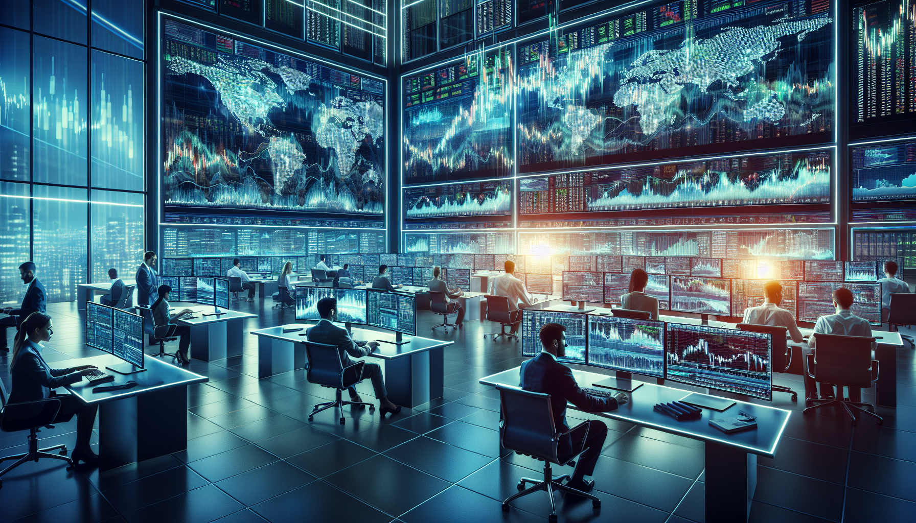
Finance: Black-Scholes
AI Prompt: “Modern financial trading floor with glowing stock charts and data visualizations, professional photography”
The Black-Scholes formula for a call option:
$$C=S_{0}N\left(d_{1}\right)−Ke^{−rT}N\left(d_{2}\right)$$
where:
$$d_{1}=\frac{ln\left(S_{0}/K\right)+\left(r+σ^{2}/2\right)T}{σ\sqrt{T}}$$
$$d_{2}=d_{1}−σ\sqrt{T}$$
AI Image: Financial markets

Slide 6
Matrix Operations
A system of linear equations can be written as:
$$\left[\begin{matrix}a_{11} & a_{12} & a_{13} \\ a_{21} & a_{22} & a_{23} \\ a_{31} & a_{32} & a_{33}\end{matrix}\right]\left[\begin{matrix}x_{1} \\ x_{2} \\ x_{3}\end{matrix}\right]=\left[\begin{matrix}b_{1} \\ b_{2} \\ b_{3}\end{matrix}\right]$$

Slide 7
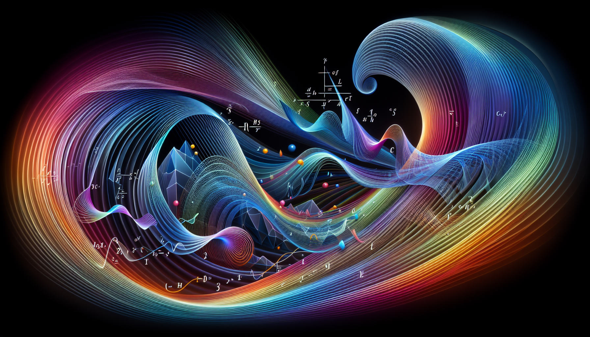
Calculus
AI Prompt: “Abstract representation of integration and derivatives with flowing curves and mathematical beauty”
The fundamental theorem of calculus:
$$\int_{a}^{b}{f}\left(x\right) dx=F\left(b\right)−F\left(a\right)$$
where $F′\left(x\right)=f\left(x\right)$
AI Image: Calculus visualization

Slide 8
Greek Letters and Symbols
Common in finance and statistics:
Returns: $r_{t}=ln\left(P_{t}/P_{t−1}\right)$
Volatility: $σ=\sqrt{\text{Var}\left(r\right)}$
Beta: $β=\frac{\text{Cov}\left(r_{i},r_{m}\right)}{\text{Var}\left(r_{m}\right)}$
Alpha: $α=r_{i}−\left(r_{f}+β\left(r_{m}−r_{f}\right)\right)$

Slide 9
Summation and Products
Sample mean and variance:
$$\overset{‾}{x}=\frac{1}{n}\sum_{i=1}^{n}{x_{i}}$$
$$s^{2}=\frac{1}{n−1}\sum_{i=1}^{n}{{\left(x_{i}−\overset{‾}{x}\right)}^{2}}$$

Slide 10
Limits and Derivatives
The definition of a derivative:
$$f′\left(x\right)=\lim_{h→0}\frac{f\left(x+h\right)−f\left(x\right)}{h}$$
Chain rule:
$$\frac{d}{dx}\left[f\left(g\left(x\right)\right)\right]=f′\left(g\left(x\right)\right)⋅g′\left(x\right)$$

Slide 11
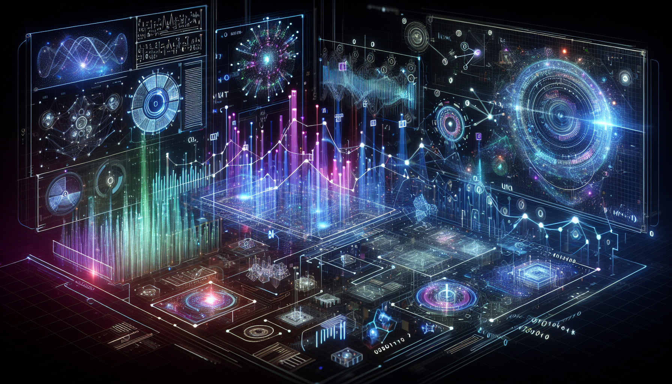
Conclusion
Quarto makes it easy to include LaTeX math in presentations
Equations render beautifully in PowerPoint
Perfect for academic and technical presentations
Export to PPTX maintains equation formatting
AI-generated images enhance visual appeal
AI Prompt: “Futuristic data visualization with mathematical formulas and AI elements, inspiring and professional”
AI Image: Success and innovation

